Slide 1
Making an Informed Choice: Know the Facts and Know the Options Surrounding Guardianship
www.arcind.org

Slide 2
Achieve with us.
Established in 1956 by parents of children with intellectual and developmental disabilities to advocate for a better life for their children.
The leading advocacy organization for people with I/DD and their families.
Committed to progressive legislation and public policy to protect rights and improve services for people with I/DD.
Home to The Arc Master Trust.
Founder of the Erskine Green Training Institute.
Affiliated with The Arc of the United States

Slide 3
Guardianship
Guardianship laws vary by state. This information is specific to Indiana. If you are planning to move to another state, contact that state’s chapter of The Arc to learn about your options.

Slide 4
What is Guardianship?
More extreme than people realize
Process of having an individual declared a “Protected Person” by the court
Proving to the court that an individual is incompetent to make decisions
Stripping an individual of some or all of their rights to make decisions except the right to vote

Slide 5
Must Go to Court
Better to have an attorney
Probate, Estate, or Elder Law attorneys
Usually need documentation from the treating physician
Varies by county
Other information can also be used in support
Average cost: $2,000 - $3,000
Some charge more; some charge less

Slide 6
Types of Guardianship
Limited guardianship
Guardian of the Person – medical treatment, living arrangements, personal contact
Guardian of the Estate – finances, property
Plenary Guardianship – “Full Guardianship”
Guardianship of the Person and the Estate
Temporary Guardianship
Emergency situations
Only for 90 days
Can extend past 90 days with court approval
Notes:
The more limited the guardianship, the better for the person
Emergency situations like death of the previous guardian; a medical emergency like a stroke or coma and someone needs to pay the person’s bills

Slide 7
Ending Guardianship
Must be terminated by the Court
Does not end when the guardian wants to stop
Does not end with the guardian’s death
Consider having a successor guardian or co-guardian in place
Some volunteer guardianship programs, professional guardians
To overturn guardianship, the Protected Person must prove they are no longer incapacitated
Ends when the Protected Person dies
Guardian may not have access to things after the individual dies except in limited areas defined in statute
Notes:
Possible to overturn, but very difficult

Slide 8
Power of Attorney
Very common among older adults and the military
Threshold – does the person understand they are giving you permission to act on their behalf?
Can be as general or specific as you’d like
Powers determined by the drafting of the POA
Can give POA access to information and the ability to make decisions for the individual
Must be notarized
Notes:
Your bank will have a notary; sometimes post office; my library has one

Slide 9
Possible Subjects for Power of Attorney
Financial matters
Medical matters
Educational matters
Government benefit matters
Notes:
By including educational matters, you can still be involved in the case conference, and you can still talk with the school

Slide 10
Power of Attorney
Pros
Considerations
No Court! Just needs to be notarized
Can have an attorney draft a specific document or download from legal websites
Allows independence
Allows the individual to keep their rights
Revocable (although revocation can be contested)
Easily transferable (for example, if the POA dies, can revoke the old POA and easily issue a new one or can include a successor in the original POA)
Notes:
Many POAs only go into effect when the person is incapacitated; I would take that requirement out

Slide 11
Formal Representation
Health Care Representative
Allows designated person to get information and make decisions about another individual
Can be set up with individual health care providers
State has a form available, but it’s not the only option
Educational Representative
No official form
Allows a designated person to represent the individual in educational matters, including the case conference
Notes:
While HCR only allows to make decisions when a person is incapacitated, will typically allow the person to speak with doctors

Slide 12
Psychiatric Advance Directive
Like other Advance Directives
Must have psychiatric diagnosis
Must be signed by the treating psychiatrist
When an individual with mental illness is competent, allows the person to state their treatment wishes when psychosis takes over
Doctors are NOT required to follow the person’s wishes, IF the doctor believes a different treatment is necessary for the person’s best interest.
Notes:
Relatively new in Indiana
Most individuals with mental illness are fine most of the time. They don’t need guardians most of the time. This allows someone to step in when the mental illness takes over
If a person has a bad reaction to a medication, explain that, and the doctor will be more likely to honor the request

Slide 13
Supported Decision Making
Going to family, friends, or experts for advice or guidance on making a decision to:
Build a team of supports of their choosing that they can "go to" when issues/problems arise, or for day to day advice
Gather information and learn to evaluate all their options
Review as many options as desired and still maintain the right to make the final decision
www.supporteddecisionmaking.org
Can use as a support, alternative, or in conjunction with guardianship
Notes:
Great webinars to watch on SDM

Slide 14
Spectrum of Assistance
Independence and self-advocacy
Formalized Supported Decision-Making
Team-based decision making (e.g., IEP, Person-centered planning process)
Agency agreements, representative payee, trustee
Limited Guardianship
Full Guardianship
Indiana Disability Rights
Notes:
By including educational matters, you can still be involved in the case conference, and you can still talk with the school

Slide 15
Spectrum of Assistance
Supported Decision-Making Concept
Guardianship
Agency Agreements
(i.e. Power of Attorney, Health Care Representative, Representative Payee, etc.)
Independence
Limited Guardianship
Informal Supports
Indiana Disability Rights

Slide 16
Considering What’s Right for Your Loved One
National Guardianship Association’s official position: “Guardianship should be utilized only when lesser restrictive supports are not available. Alternatives to guardianship, including supported decision making, should always be identified and considered whenever possible prior to the commencement of guardianship proceedings.”
Least Restrictive Model
Notes:
In school, fight for least restrictive environment; apply the same principle to guardianship
Guardianship prevents independence

Slide 17
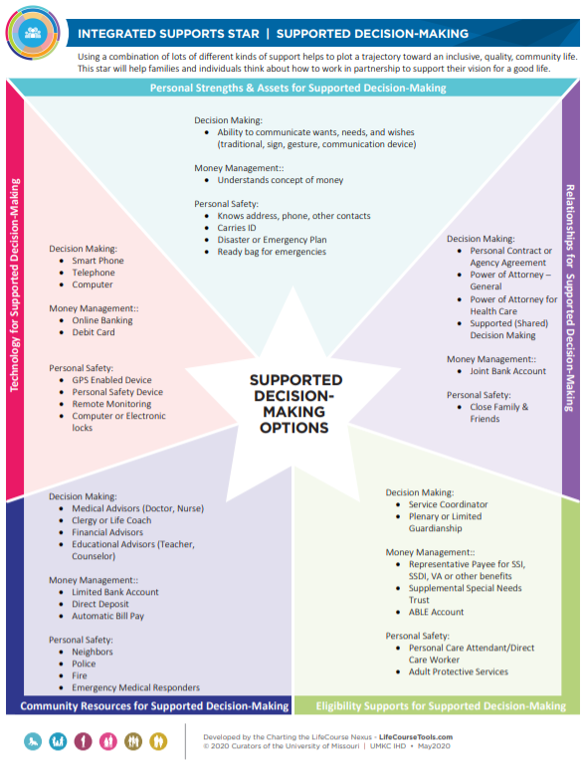
LifeCourse Tools
Notes:
In school, fight for least restrictive environment; apply the same principle to guardianship
Guardianship prevents independence

Slide 18
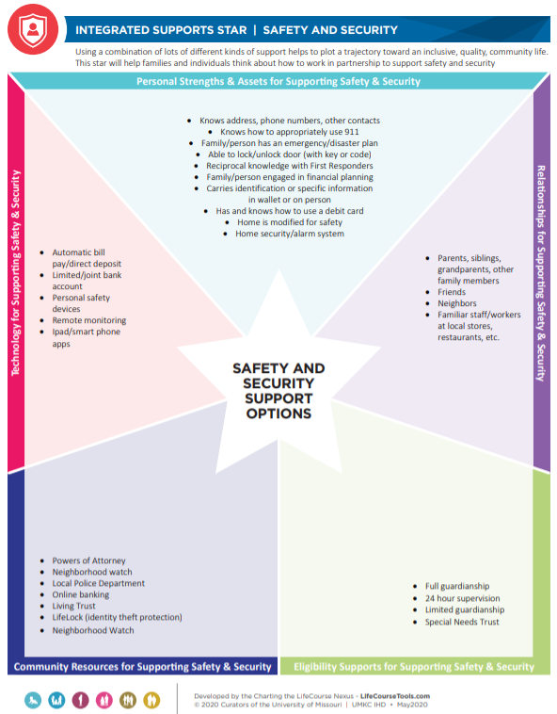
LifeCourse Tools
Notes:
In school, fight for least restrictive environment; apply the same principle to guardianship
Guardianship prevents independence

Slide 19
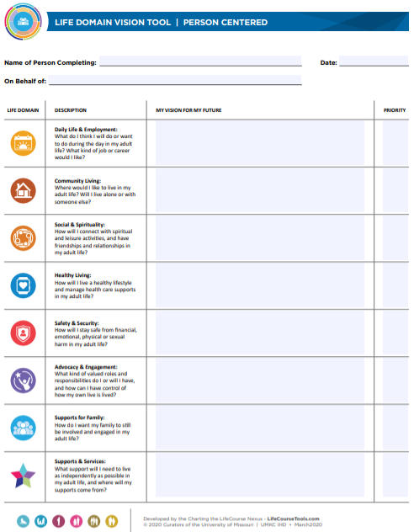
LifeCourse Tools
Notes:
In school, fight for least restrictive environment; apply the same principle to guardianship
Guardianship prevents independence
Lifecourse has the philosophy that everyone has the right to live,laugh, love in their community. It's the idea of people living their best life possible and then what are the tools that they need to achieve this. You would look at a person strengths. What they like and don't like. What resources are available 2 help them achieve their goals. Lifecourse Looks at every stage of life early childhood school age transition to adulthood , adulthood and even aging. Then they break each group down into domains which can be employment, community living, spirituality.

Slide 20
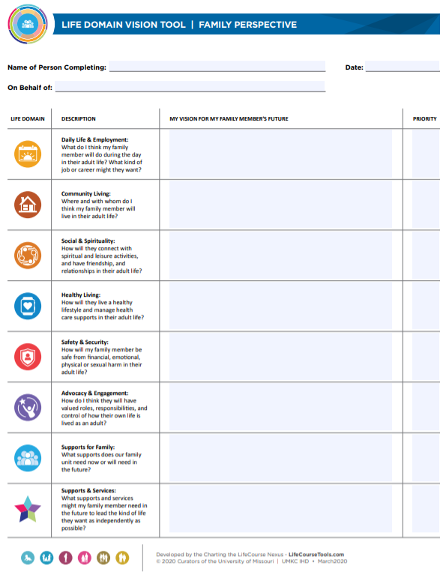
LifeCourse Tools
Notes:
In school, fight for least restrictive environment; apply the same principle to guardianship
Guardianship prevents independence

Slide 21
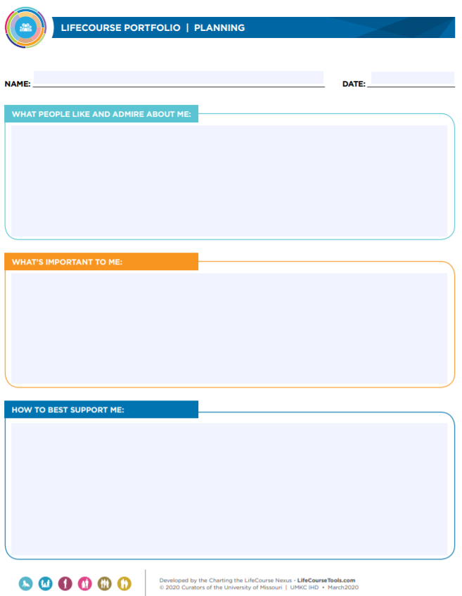
LifeCourse Tools
Notes:
In school, fight for least restrictive environment; apply the same principle to guardianship
Guardianship prevents independence

Slide 22
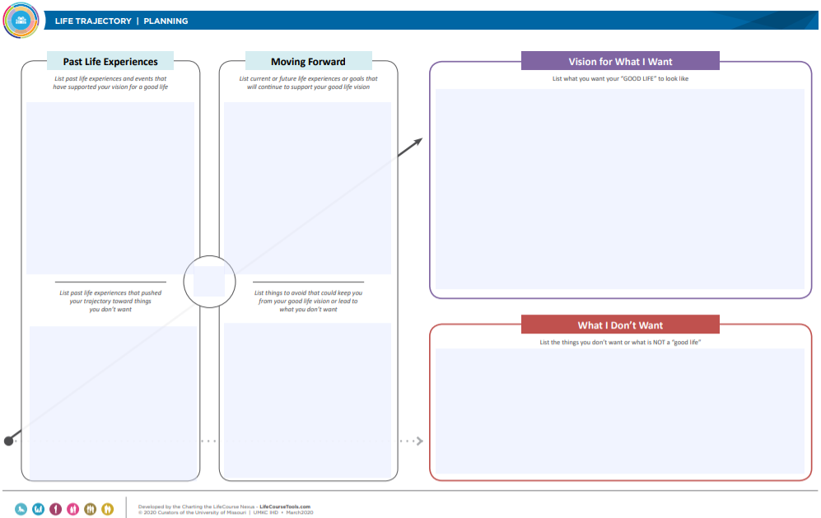
LifeCourse Tools
Notes:
In school, fight for least restrictive environment; apply the same principle to guardianship
Guardianship prevents independence

Slide 23
Dignity of Risk
“He doesn’t make the best choices.”
There’s not a parent of an 18 year old out there who doesn’t feel the exact same way
We all learn from bad choices
We need to let them try
Be there to help them make decisions
Be there to help them understand consequences of their decisions and the next steps
Teach them to use a Supported Decision Making Model to come to you first as a matter of routine and a regular part of the decision making process

Slide 24
When in doubt or confused, please ask!
If the information you receive from another source differs from this presentation, it may be because of actual changes or because the person you asked is not aware of the changes.
Please ask a Family Advocate with The Arc Advocacy Network!
We’re Here to Help
The Arc Advocacy Network is funded through a grant from the Indiana Division of Disability and Rehabilitative Services

Slide 25
Stay Informed
Visit: www.arcind.org
Sign up for E-Newsletters and Action Alerts
Join The Arc of Indiana on Facebook and Twitter and Instagram @TheArcIN
Listen to our podcast www.arcind.org/podcasts

Slide 26
The Arc Advocacy Network a program of The Arc of Indiana funded by the Indiana Division of Disability and Rehabilitative Services
800-382-9100 317-977-2375 www.arcind.org
lifecoursetools.com

